Slide 1
NLP
From Words To Insights
Unstructured Text Analysis for Anticipating AI shift in Job Industry
~ a project work by GARIMA SOHI

Slide 2
TABLE OF CONTENTS
EXECUTIVE SUMMARY………………………………………..…………………………….……….….4
RECOMMENDATIONS…………….……………………………………….………………...…….…6-9
DATA PRE-PROCESSING……………………………………………..………………….………..11-13
TOPIC DETECTION………………………………….…………………….………………….……….15-17
SENTIMENT ANALYSIS……………………………………………………..……..…….………..19-21
TRENDS OVER TIME.………………………………………………………..…….…….…………..…23
ENTITY IDENTIFICATION………………………………………………………….…………....25-26
TARGETED SENTIMENT IDENTIFICATION………….………………………..……….28-30

Slide 3
01
Executive Summary
3

Slide 4
Executive Summary
OVERVIEW:
The project conducted an in-depth analysis of the current state of AI technology and its potential impact on various industries, jobs, and workforce at large. Utilizing a vast corpus of around 200,000 news articles, it investigated trends, sentiments, geographical distribution, potential benefits, and risks associated with AI.
INSIGHTS:
Large Language Model, 'chatgpt', received predominantly positive sentiment due to its role in sparking an AI revolution. However, negative sentiments were associated with its outages, potential impact on student learning, job elimination, and potential facilitation of hate speech. AI has been trending consistently since 2020, with a peak in interest from Google in 2023, and the most engagement in the US, followed by India and China.
Several business lines have emerged as primary beneficiaries of AI investment. These include healthcare, defense, media, education, finance, AI chipsets, cyber security, music/entertainment, air quality checks, food/beverages, and automotive. However, the rise of AI is not without potential downfalls. Concerns include unauthorized data collection, political manipulation, deepfakes, cheating in educational settings, health data breaches, and general data privacy breaches.
CONCLUSION:
The insights gleaned from this project present a nuanced picture of AI's role in our future. On the one hand, AI continues to revolutionize industries, offering the potential to significantly improve productivity and solve complex problems. On the other hand, the misuse of AI technologies, particularly around data privacy and security, must be addressed.
4

Slide 5
Recommendations
02
5

Slide 6
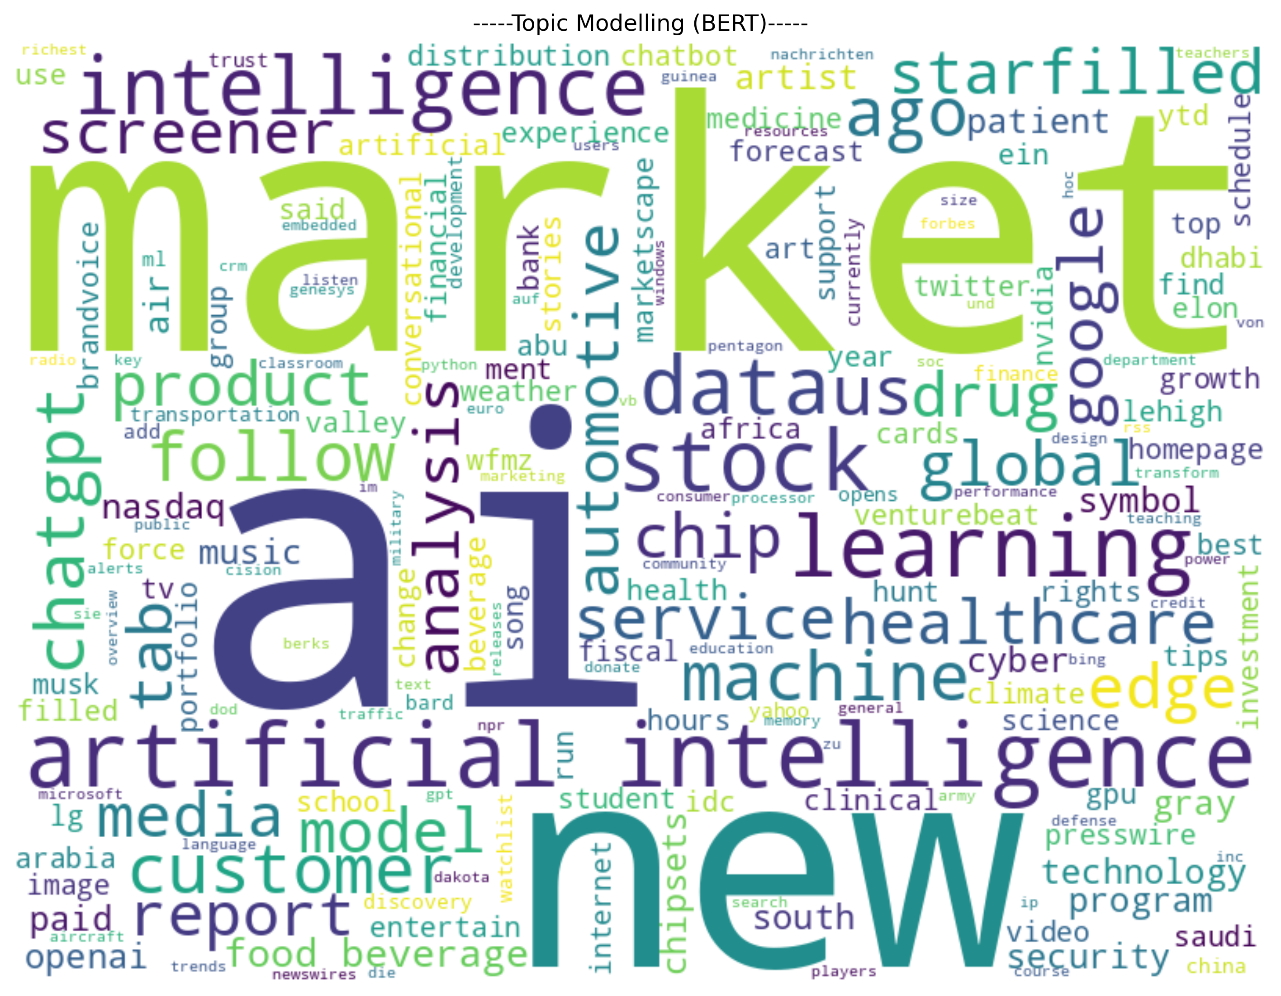
A. Application Success in AI
Some lines of business that should invest in AI are as follows:
Healthcare
Defense
Media
Education
Finance
AI Chipsets
Cyber Security
Music/Entertainment
Air Quality Check
Food/beverages
Automotive
Figure 1
6

Slide 7
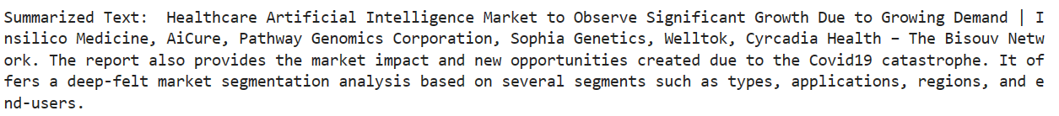
Sample News Articles highlighting success stories of AI (Using K-train Summarization):
DEFENSE
MUSIC
HEALTH
CHI PS
7

Slide 8
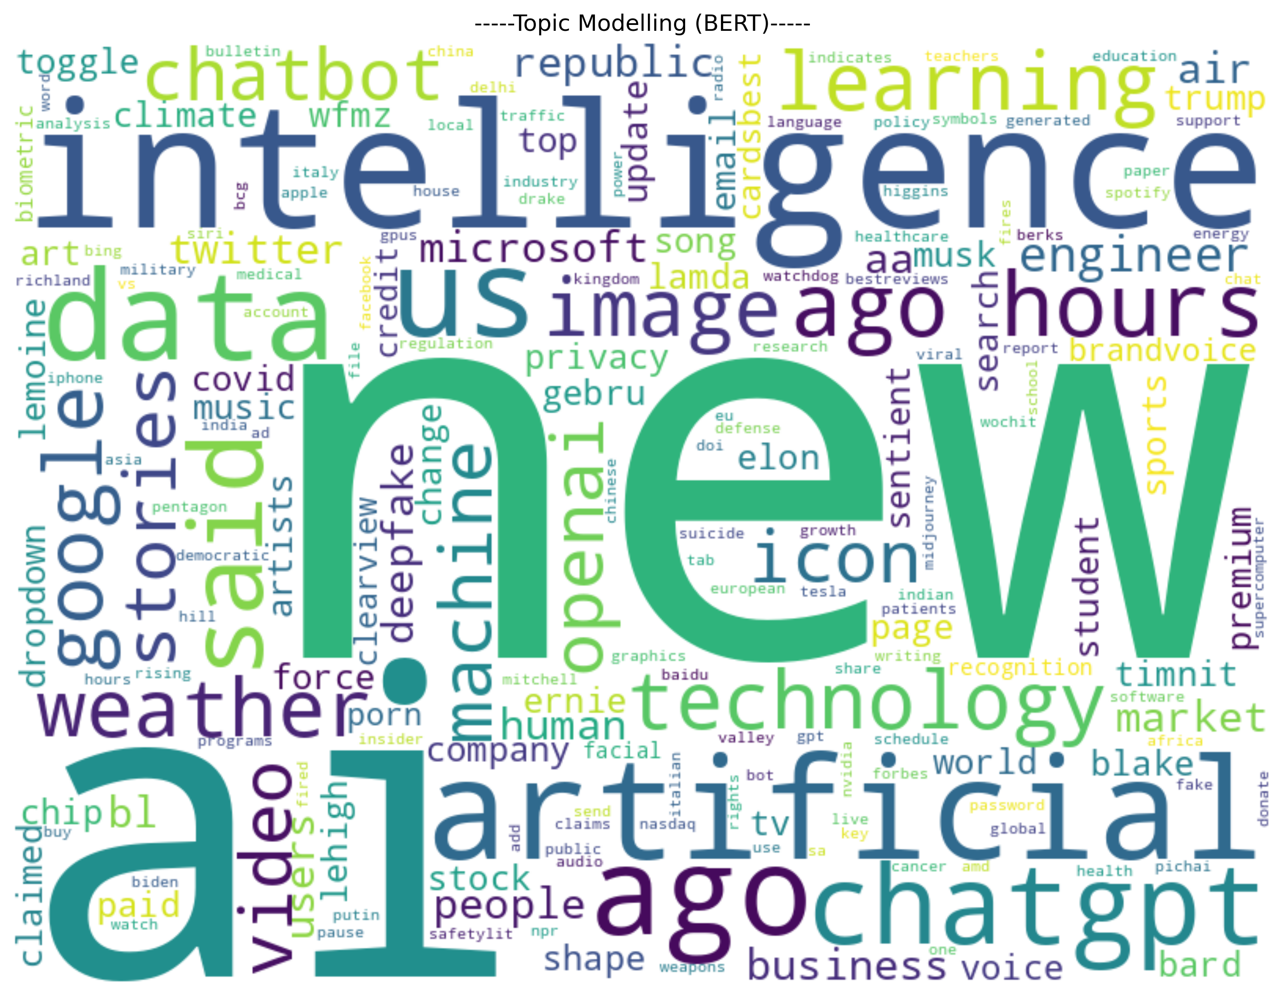
B. Application Failures in AI
Applications that may result in downfall of AI are:
Data Collection without permissions (images, videos etc.)
Politics
Deepfakes
Learning for students as students may cheat to pass the exams in schools
Health Data breaches
Data Privacy breaches
Figure 2
8

Slide 9
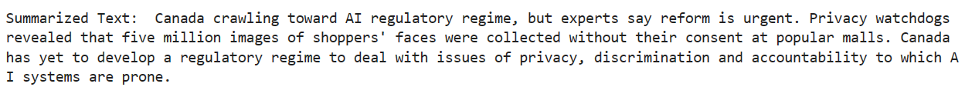
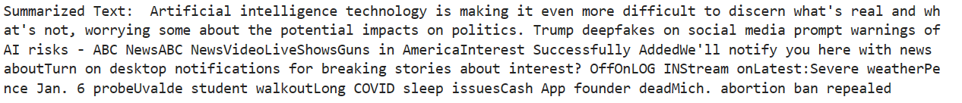
Sample News Articles highlighting failures in AI (Using K-train Summarization):
9

Slide 10
03
Data Pre-Processing
10

Slide 11
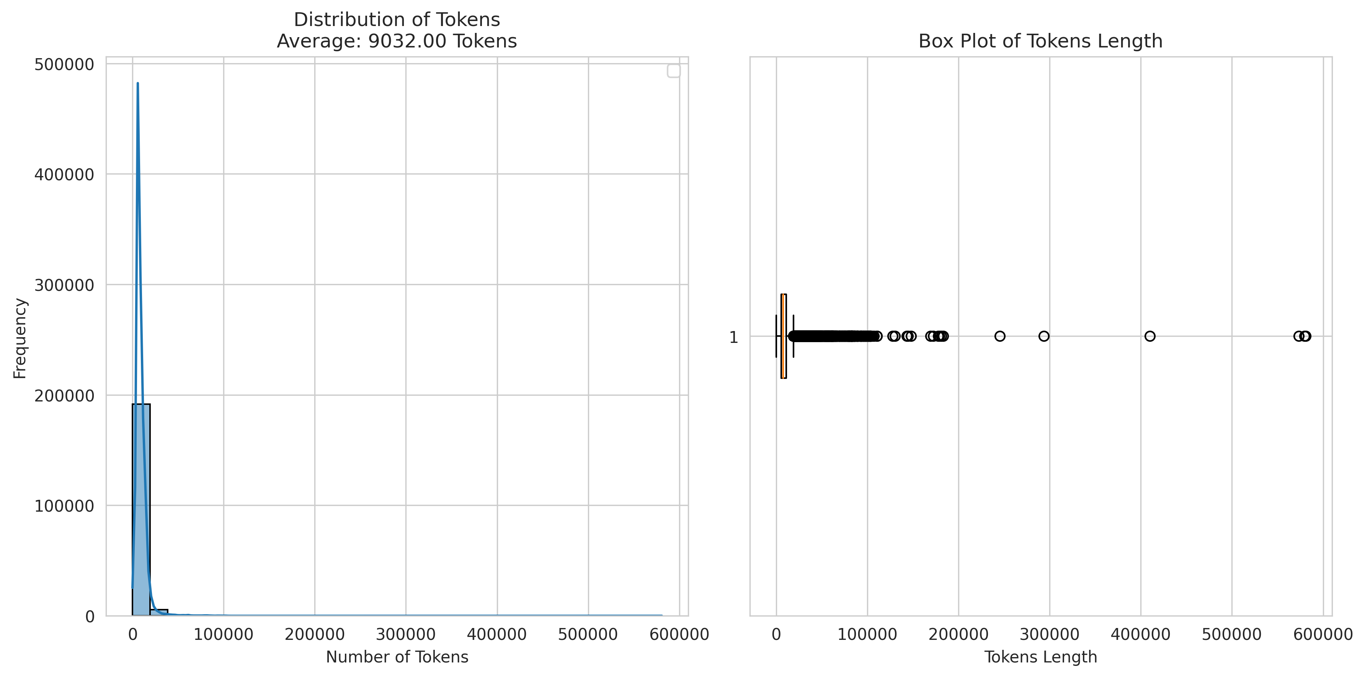
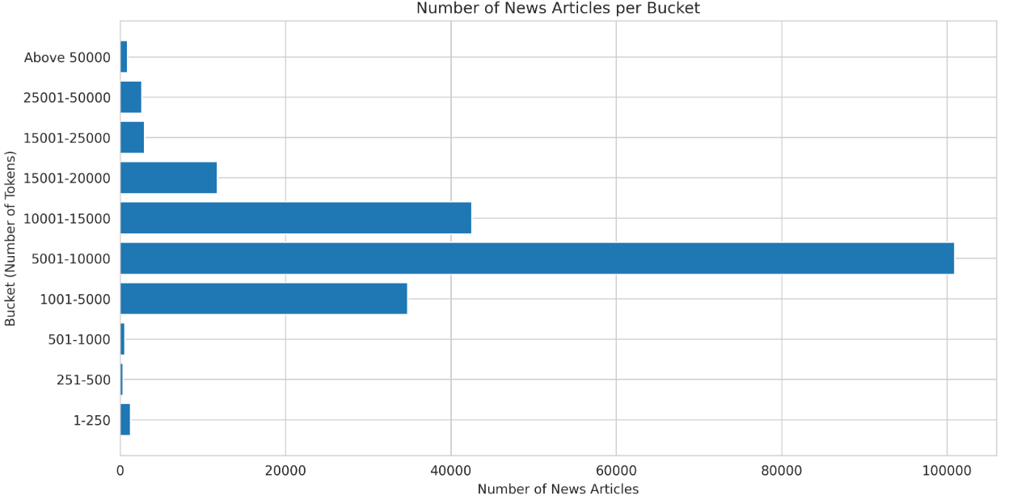
UNDERSTANDING TOKEN DISTRIBUTION IN NEWS ARTICLES
Initial dataset of ~200K articles with zero missing values.
Token Distribution in the news articles is highly skewed in nature because of the possible outliers in news articles having number of tokens over 100K. (Figure 1)
Thus, bucketized the distribution of tokens in news articles to understand underlying the proportion.
It was found that ~96% of news articles have token distribution between 1000 and 20000. (Figure 2)
Figure 3
Figure 4
11

Slide 12
200K data points
DATA PROCESSING FLOW
STAGE 1
STAGE 2
STAGE 3
STAGE 4
STAGE 5
198K
data points
190K
data points
190K
data points
160K
data points
Initial dataset of News Articles
Implemented following steps:
Data Cleaning
Lemmatization
Removing Duplicates
Bucketized the news articles based on number of tokens in text
Limited the News Articles with minimum number of tokens = 1K & maximum number of tokens = 20K in text
Prepared a list of relevant keywords using K-means, Word2Vec & Bertopic
Filtered the dataset on the prepared keyword list to retrieve the final set of news articles
12

Slide 13
ANALYSIS PIPELINE
Identified the optimal model with better results on topic identification from LDA & BERT
Discarded irrelevant articles and prepared final dataset for analysis
Performed sentiment analysis using Flair package
1. Data Pre-Processing
2. Topic Modelling
3. Sentiment Analysis
4. Named Entity Recognition
5. Targeted Sentiment Analysis
6. Recommendations
Identified key identities in the news articles using SPacy
Performed targeted sentiment analysis on entities with labels as Organizations, People, Locations
Generated recommendations using WordCloud
13

Slide 14
04
Topic Detection
14

Slide 15
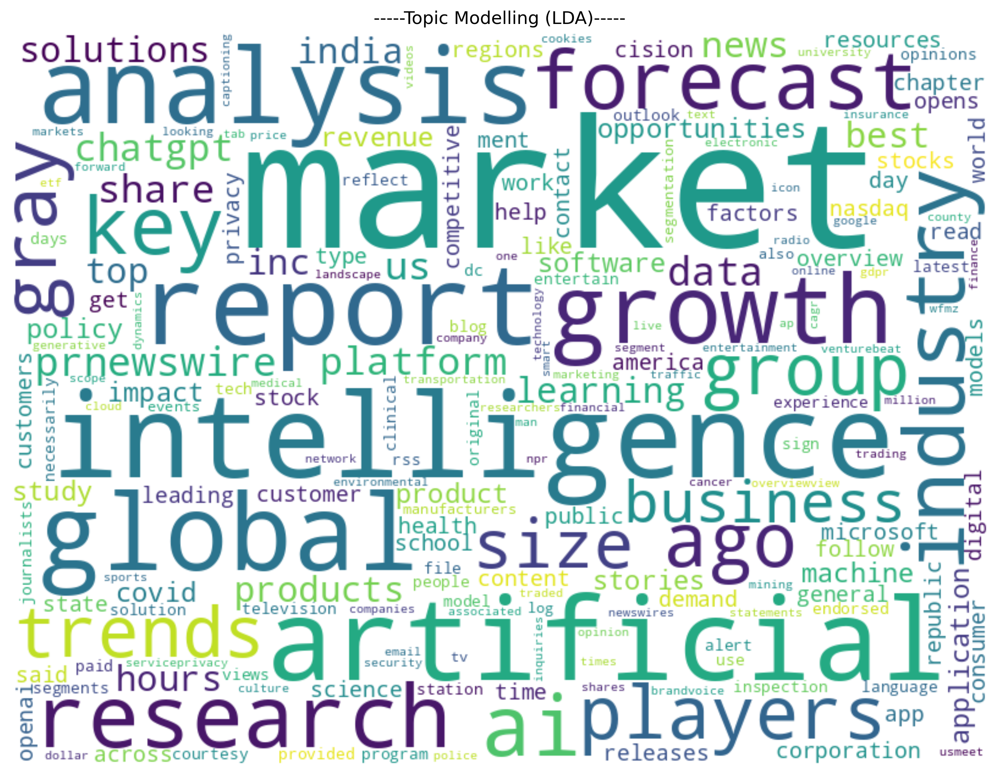
IDENTIFYING KEY TOPICS
A. USING LDA
Discovered the optimal number of topics = 12 using the default parameters of LDA model.
As can be seen in WordCloud of LDA (Figure 3), main topics were around:
Artificial Intelligence
ChatGPT
Market Growth etc.
Although topics were related to AI, however, I found it difficult to locate specific industries in the topics.
Figure 5
15

Slide 16
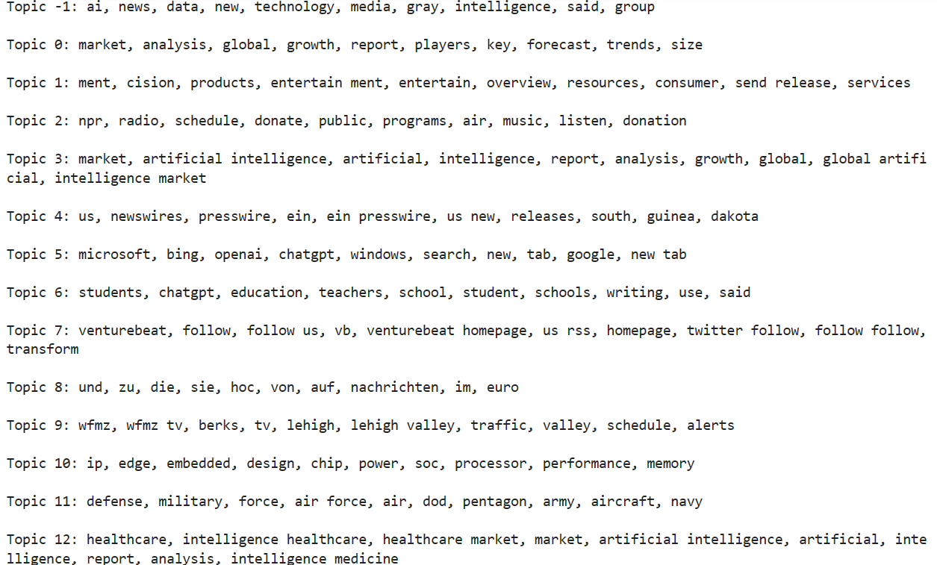
B. USING BERTOPIC
Another method I explored to identify key topics was using BERT.
The number of total topics found in the entire corpus of news articles came out to be 267.
Figure 4 shows some key topics from the result, and it can be noticed that BERT performed better in identifying relevant industries in addition to AI related keywords.
Figure 6
16

Slide 17
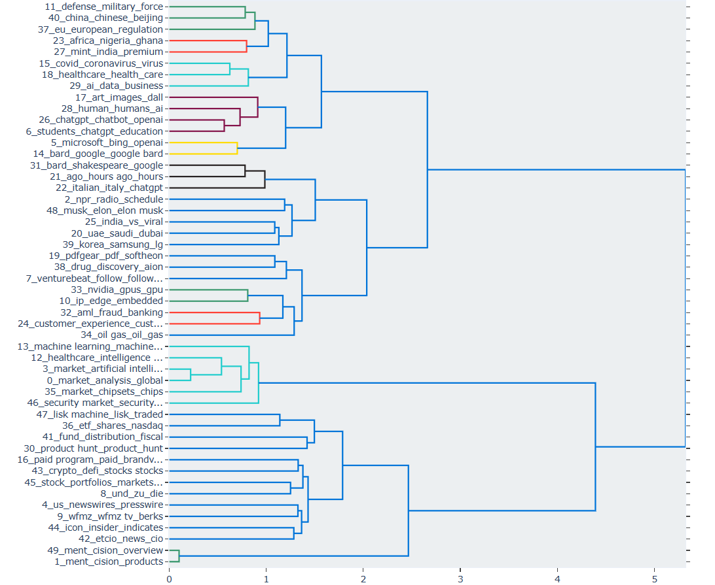
TOPIC DETECTION USING BERT
Identified topics are as follows:
artificial intelligence
chatgpt
bard
healthcare
openai
microsoft
google
machine learning
covid
media
market
education
elon musk etc.
Figure 7
17

Slide 18
05
Sentiment Analysis
18

Slide 19
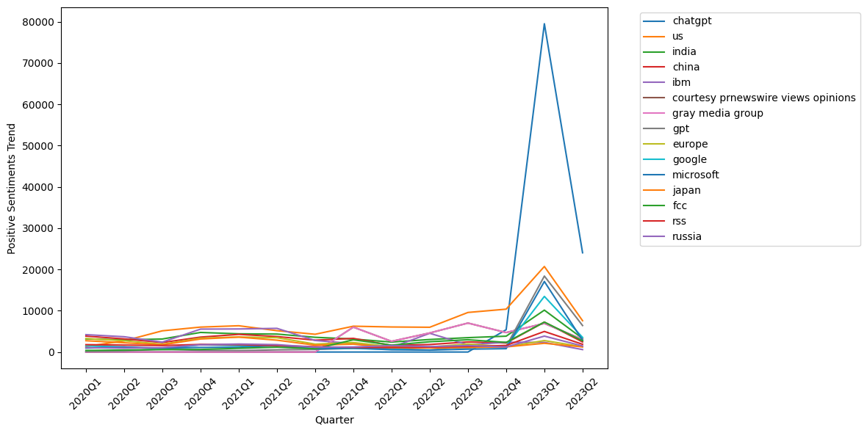
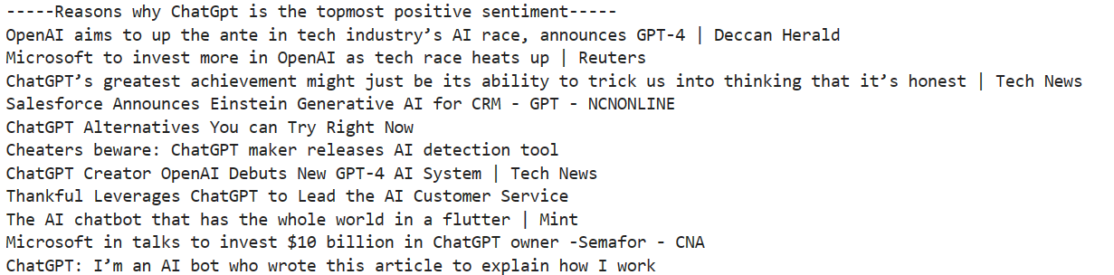
A. POSITIVE SENTIMENTS
Using Flair Package, ~83% articles appeared to have positive sentiments and remaining 17% had negative sentiments.
In the positive sentiments' dataset, it was found that ‘chatgpt’ is the topmost positive sentiment talked about specially between the 4th quarter of the year 2022 and 2nd quarter of year 2023.
Further, US location started to trend from similar timeframe. (Figure 6)
There are multiple reasons as can been in Figure 7 for chatgpt to appear as most positive sentiment, which mainly talk about the AI revolution it brought in the whole world.
US (location)
Figure 8
19
Figure 9

Slide 20
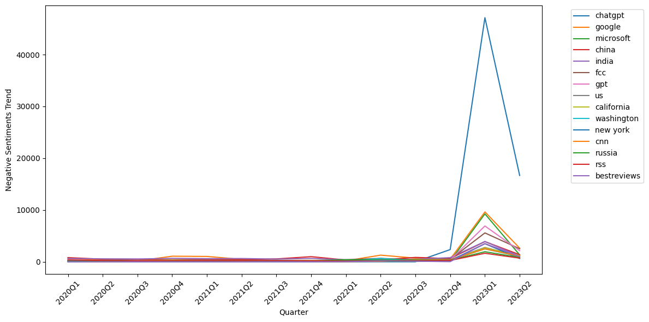
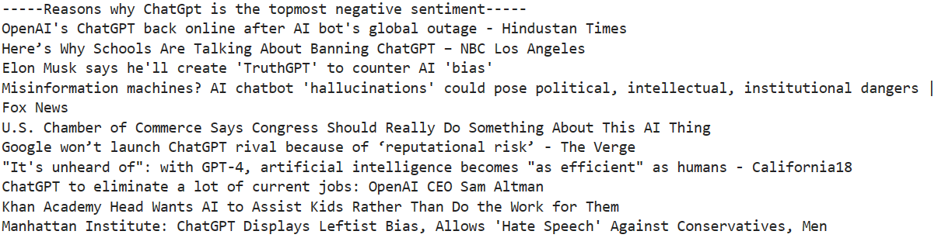
B. NEGATIVE SENTIMENTS
In the negative sentiments' dataset, again ‘chatgpt’ is the topmost sentiment talked about specially between the 4th quarter of the year 2022 and 2nd quarter of year 2023. (Figure 8)
Negative sentiment for chatgpt were associated with its outage issues, how it might impact student’s learning and schools thinking of banning its use, elimination of current jobs with chatgpt, allowing hate speeches etc. (Figure 9)
Figure 10
Figure 11
20

Slide 21
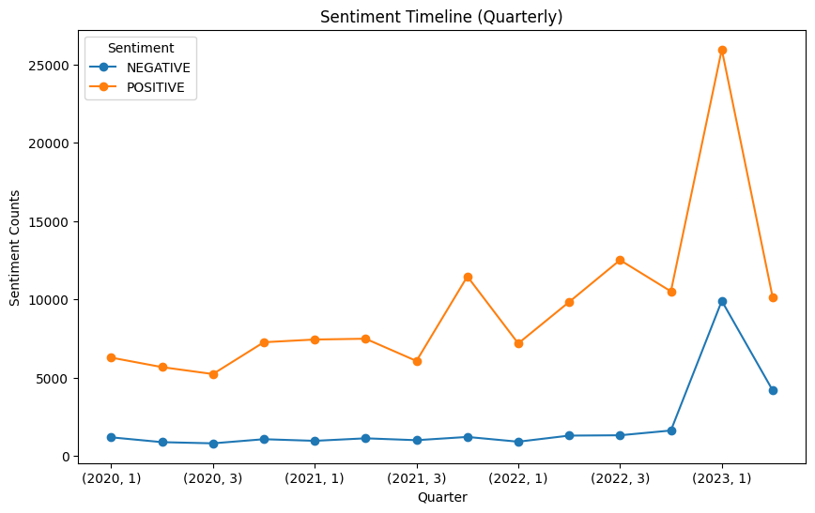
C. SENTIMENTS OVER TIME
Overall sentiments were trending low until the boom of chatgpt in the quarter 4 of year 2022, for which the sentiments were expressed more both in positive and negative aspect.
Overall sentiments were trending low until the boom of chatgpt in the quarter 4 of year 2022, for which the sentiments were expressed more both in positive and negative aspect.
Figure 12
21

Slide 22
AI Solutions Trends over Time
06
22

Slide 23
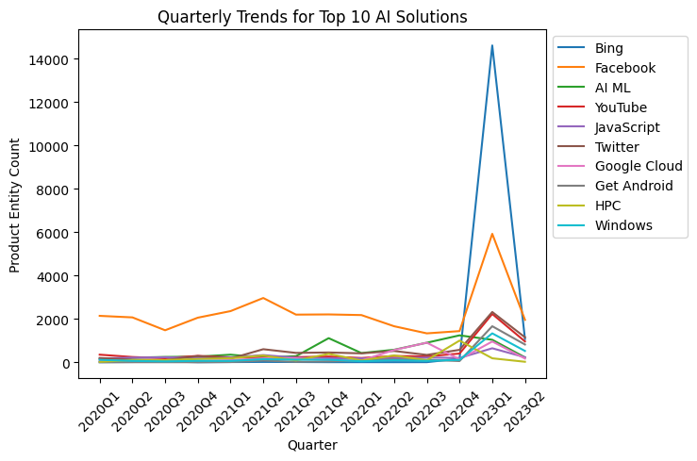
AI Solutions Trends over Time
AI solutions that are trending from 2020 can be seen in Figure 11. All products are showing stable trend, except Bing which peaked in the first quarter of 2023.
This maybe due to several reasons (like in Figure 12), however, the major reason could be the chatgpt revolution, in which Microsoft invested and added AI features to Bing.
Figure 13
23

Slide 24
07
Entity Identification
24

Slide 25
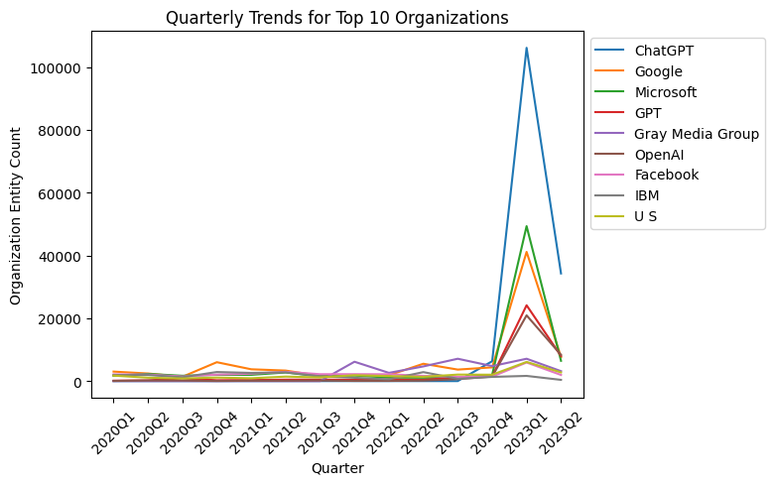
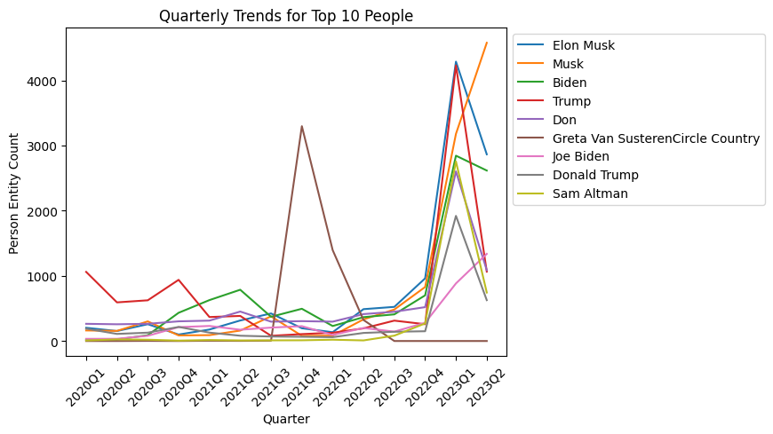
Top Entity Discovery – Organizations & People
Figure 14
Figure 15
Top organizations (ChatGPT, Google, Microsoft) confirms the presence of AI boom that happened in the last quarter of 2022.
Musk remain on the top since the ChatGPT boom started, along with political personalities and CEO of OpenAI.
25

Slide 26
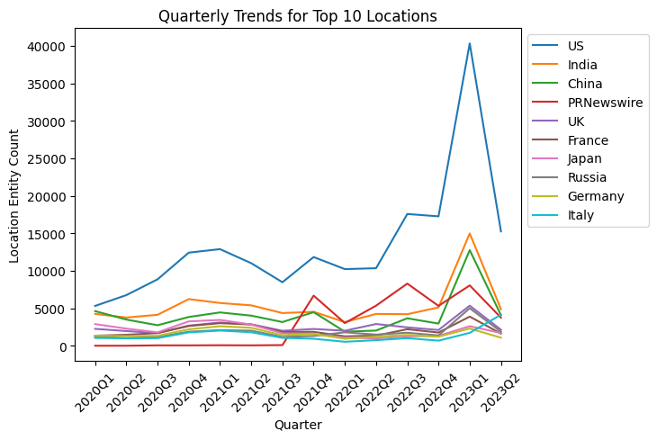
Top Entity Discovery - Locations
Top locations include US, India & China with US being on the top. (Figure 17)
Further, we can see in summarization (Figure 18), how these locations are related to AI technology, cyber attacks etc.
Figure 16
Sample News Articles for Locations (Using K-train Summarization):
26
Figure 17

Slide 27
08
Targeted Sentiment Identification
27

Slide 28
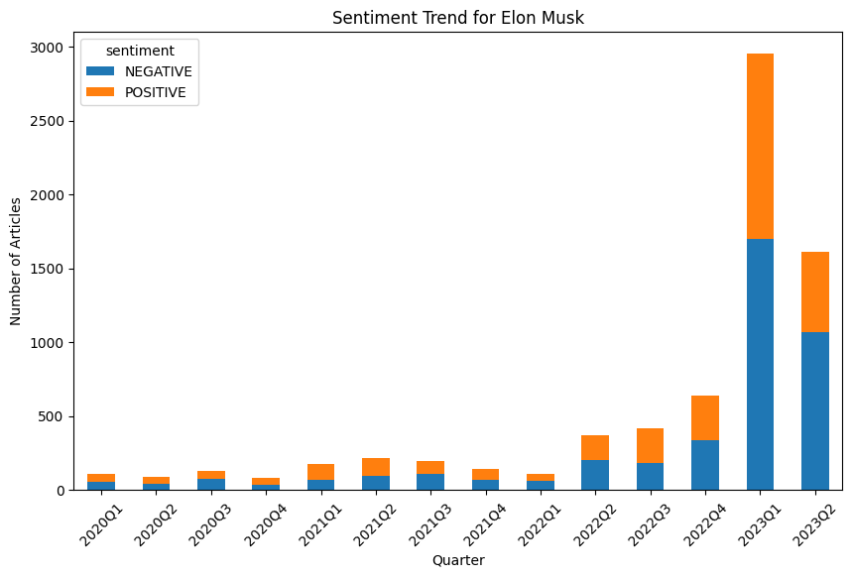
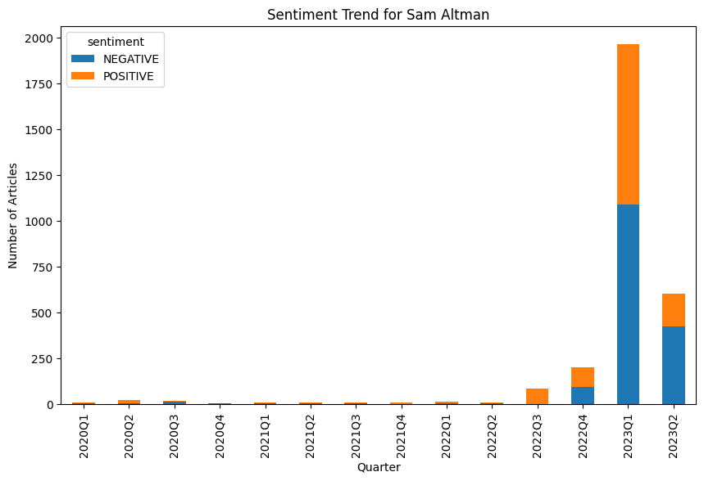
Targeted Sentiment Analysis
Elon Musk | Sam Altman
Figure 18
Figure 19
Elon Musk always trending in news, and sentiments peaked for him in 2023.
On the other hand, Sam Altman (CEO of OpenAI) was hardly in news before ChatGPT AI revolution. However, with the advent of OpenAI, news articles mentioning both positive & negative sentiments related to him increased exponentially. Overall Sentiments reduced for him in second quarter of 2023, but negative sentiments remained more than positive.
28

Slide 29
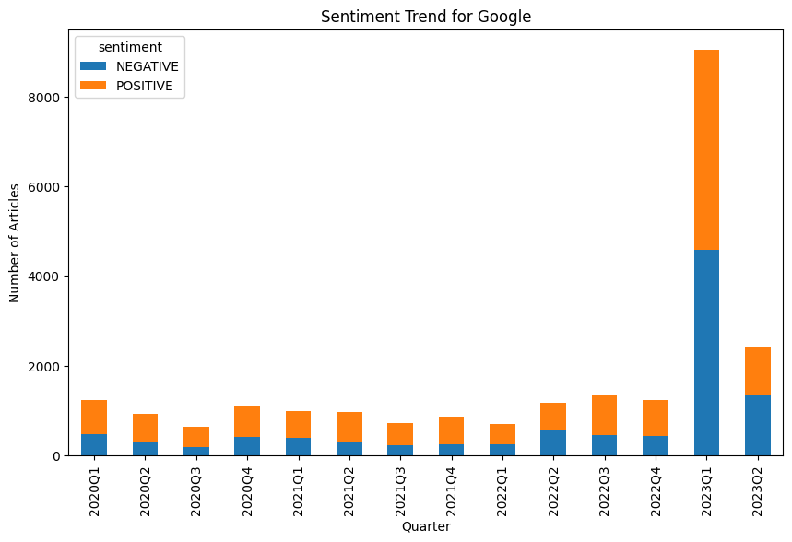
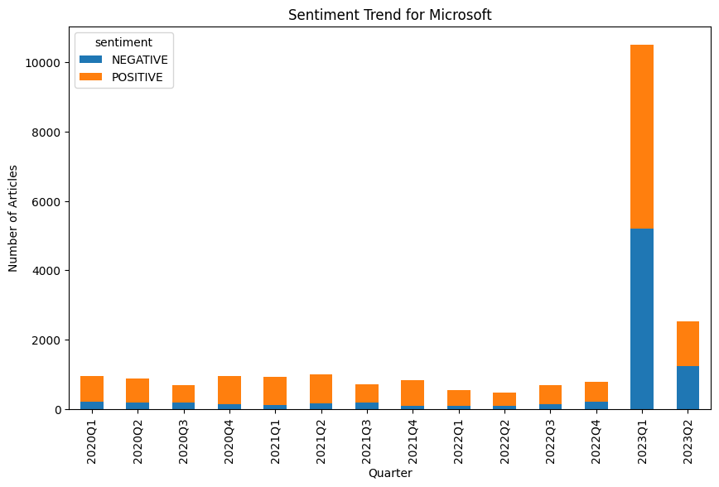
Targeted Sentiment Analysis
Google | Microsoft
Figure 20
Figure 21
Microsoft was mentioned a little less than Google in news, but in the first quarter of 2023, its popularity increased because of huge investment in OpenAI and it was mentioned more in ~2k news both for positive and negative sentiments than Google.
29

Slide 30
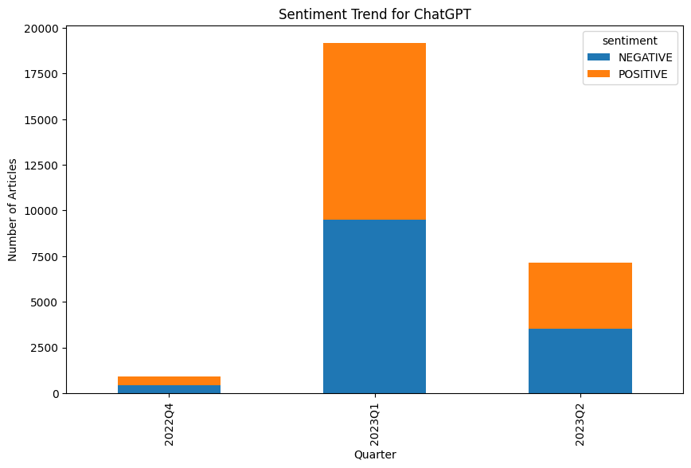
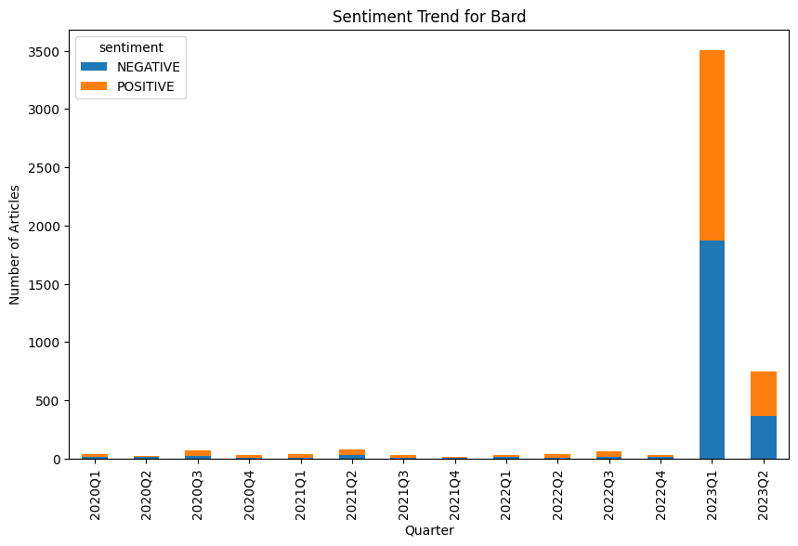
Targeted Sentiment Analysis
ChatGPT | Bard
Figure 22
Figure 23
This comparison is very interesting since ChatGPT was not mentioned at all before 4th quarter of 2022 and as soon as it became a popular demand in 2023, Google released Bard as a response (evident from the sentiments plot).
Even after the release of Bard, ChatGPT still remained majorly in news articles with upper limit of ~20K news articles.
30

Slide 31

THANK YOU

